Slide 1
Welcome to Our Presentation

Slide 2
Development of Bus Ticket Management System for “TT Bus Paribahan”

Slide 3
Group Member
ID | Name
17103212 | Md Khaledul Islam
17103263 | Afsana Akter Lija
17103272 | Md. Abir Hasan
17203106 | Mohammad Iqbal Hossain

Slide 4
ORGANIZATION PART
Organization Overview
TT Bus Paribahan is known for its higher quality bus service and a good number of quality driver. The company was established in 2002 for the requirement of quality bus among the country.
Mission Statement
To improve our customer’s lives and our community through passenger transportation services.
Vision for our Customers
Make travel convenient, enjoyable and beneficial for all who use our services by exceeding our customers’ expectations and enabling them to achieve their travel and transportation goals.

Slide 5
PROJECT INTRODUCTION
This project is designed and developed for TT bus paribahan, Gabtoli , Dhaka.

Slide 6
Objectives
The main objectives of the online system include:
To provide a web-based bus ticket buying functions. Customer can buy bus ticket through the online system and no need to queue up to buy bus ticket at the counter.
To enable customer to check the availability of the bus ticket online. Customer can check the time departure and arrival for every Transnational’s bus through the system.
To ease the bus ticket payment by online. Customer has to pay the bus ticket by online
To reduce the number of staff at the point of sale. The number of staff at the counter can be reduced after the online buying bus ticket system launch.
.

Slide 7
Project Limitations
Payment gateway : Online payment gateway is not added yet.
Limited system testing: improper unit and system testing may pose some usability issues such as delays in some modules.
.

Slide 8
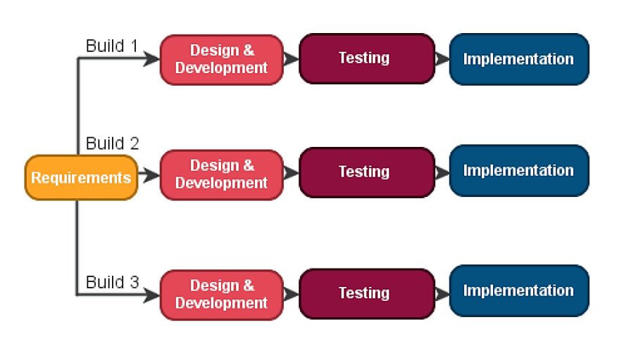
PROCESS MODEL This web-based software for TT bus paribahan is fully relies on iterative software process model.

Slide 9
Iterative Model
Features of Iterative Model
Requirements are clearly defined and understood.
Major requirements must be defined; however, some functionalities or requested enhancements may evolve with time.
There are some high-risk features and goals, which may change in the future.
Better suited for large and mission-critical projects.
Advantages of Iterative Model
Some working functionality can be developed quickly and early in the life cycle.
Results are obtained early and periodically.
Parallel development can be planned.
Progress can be measured.

Slide 10
Feasibility study
The objective of feasibility study is to determine whether the proposed system is feasible or not.
Three types of feasibility study-
Technical Feasibility
Economic Feasibility
Operational Feasibility

Slide 11
REQUIREMENT ENGINEERING
Requirement Analysis
Project requirements are conditions or tasks that must be completed to ensure the success or completion of the project.
Hardware Requirements
❖ A minimum of Pentium 4 with a speed of 1.3 GHz.
❖ A minimum RAM capacity of at least 512MB.
❖ Hard disk capacity of at least 100mb free space.
Software Requirements
❖ Windows 7 and above.
❖ Xampp Server.
❖ Web Browser (Firefox or Chrome)

Slide 12
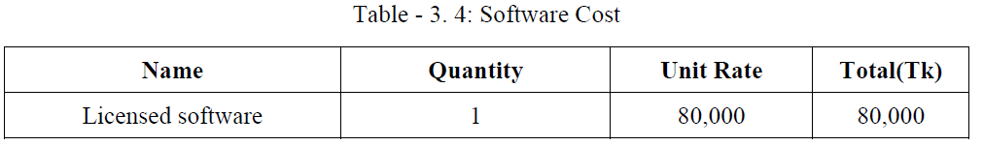
COST ESTIMATION
Hardware cost :
Software cost :
Name | Quantity | Unit Rate | Total(Tk)
CPU | 1 | 15000 | 15000
Monitor | 1 | 7000 | 7000
Keyboard | 1 | 350 | 350
Mouse | 1 | 250 | 250

Slide 13
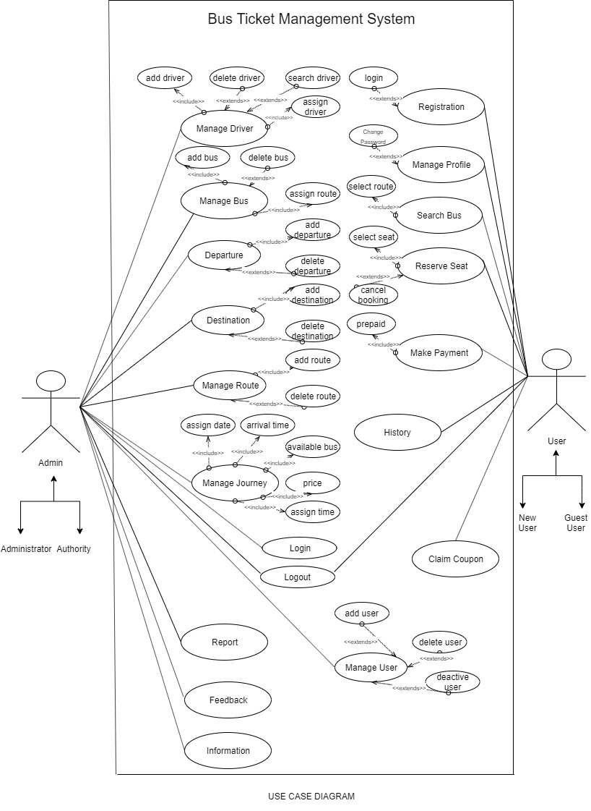
ANALYSIS AND DESIGN

Slide 14
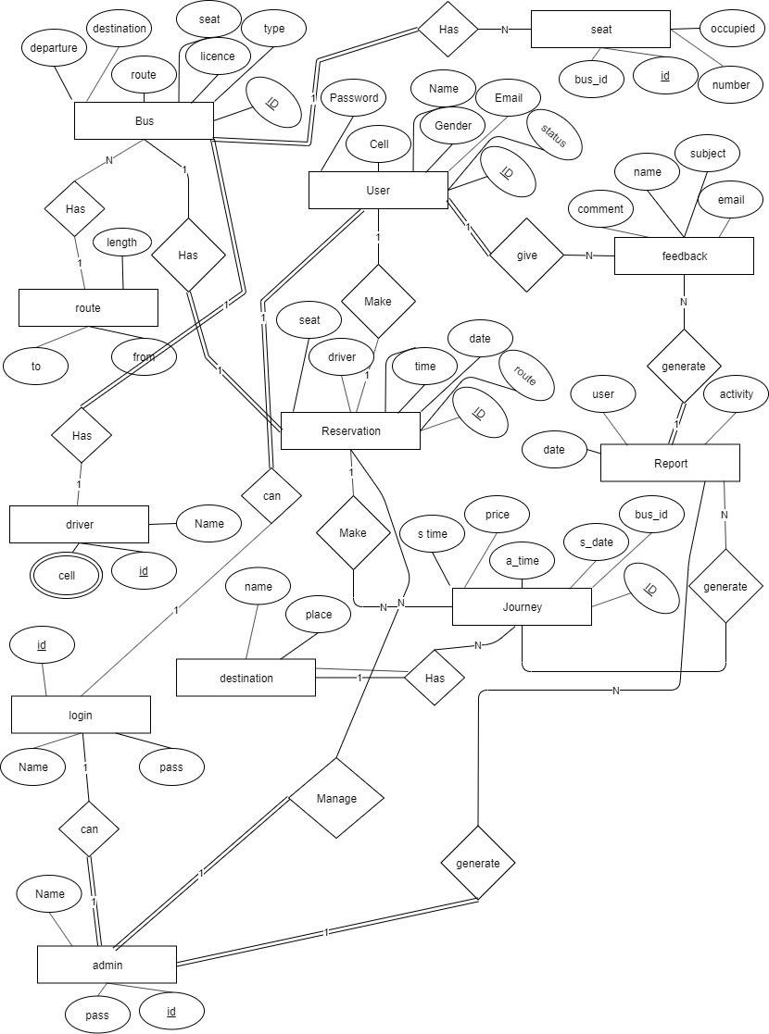
ERD

Slide 15
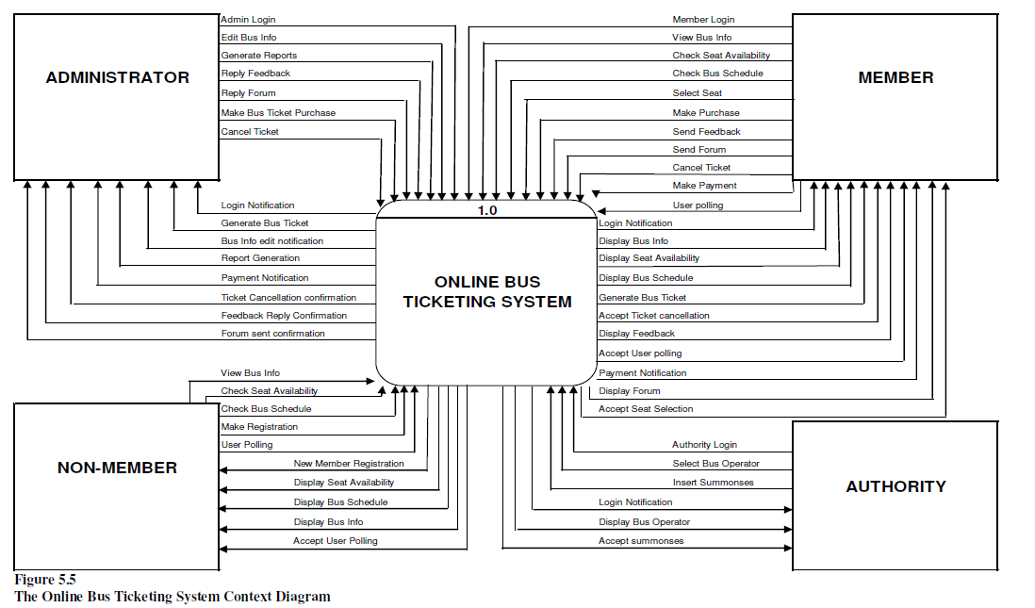
DFD (DATA FLOW DIAGRAM) Contest Level:

Slide 16
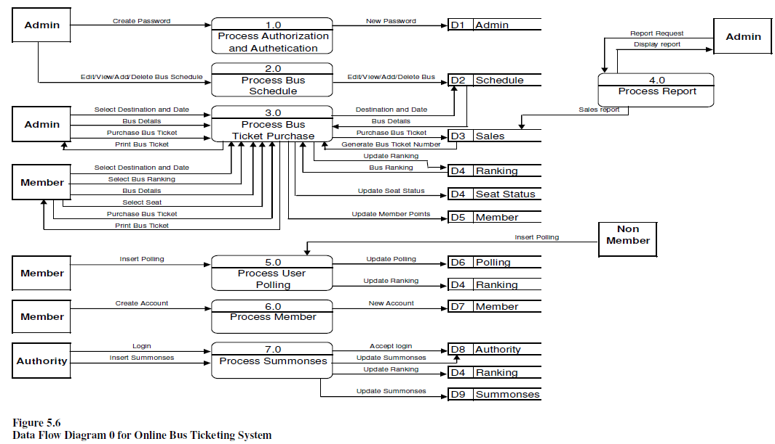
DFD (DATA FLOW DIAGRAM)

Slide 17
RISK ENGINEERING
RISK MANAGEMENT
Risk management is the process of identifying and migrating risk.
Increase probability of positive event.
Reduce the occurrence of negative event.

Slide 18
RISK ENGINEERING
Project Risks:
Changing client requirements.
Poor quality documentation.
Lack of development experience.
Technical Risks:
Computer crush.
Technology doesn’t meet spacifications.
Poor training skill in team members.
Business Risks:
Insufficient Budget.
No pay the installment of software cost.
Late delivery of the project.

Slide 19
QUALITY ASSURANCE MATRIX
Quality Assurances Matrix is a standardized process that takes potential or actual Quality concerns, their importance to customer satisfaction and evaluates the robustness of the manufacturing and inspection processes against the potential or actual seriousness of the concern.
WHITE BOX TESTING:
Control flow testing
Data flow testing
Branch testing
Statement coverage
BLACK BOX TESTING:
Initially requirements and specifications of the system are examined.
Tester determines expected outputs for all those inputs.
Software tester constructs test cases with the selected inputs.
The test cases are executed.

Slide 20
Conclusion
This chapter discusses on the outcome of this entire research, limitations of the research and last but not least the future outcome of this research. Finally, this chapter concludes the various issues that had been highlighted in the earlier chapters. Knowledge in terms of concept, theory, technical and practical aspects on Online Bus Ticketing System web portal had been gained.
Limitations of the research
There were few constraints that had been encountered during completing the research document. The first constrain was the inability to find any research document obtaining information on star ranking for bus operators. It was difficult to acquire any information on this area because there are no any governing bodies that award ratings to bus operators as how hotels and airliners are rated.

Slide 21
Conclusion
Future work of the research
Some of the future work of the research for this Online Bus Ticketing web portal that can be taken into consideration are-
(a) Language Support
(b) Enhanced User Interface
(c) Increase Administrators Task
(d) Common working community

Slide 22
Thank You

Slide 23
Do you have any question ?

